Slide 1


CSE 3000 Presentation
Topic:
Content Moderation with Multinominal Naïve Bayes
Ethan Carty, Adam Chao, Noor Sharaf, Connor Shaw, and Will Shostak

Slide 2

01 - Introduction
02 - Analysis
03 – Ethical Discussion
04 – Conclusion

Slide 3

01 - Introduction
Content Moderation
Ongoing challenge for social media platforms
New and developing vocabulary/slang
Dataset – Jigsaw's Toxic Comment Classification Challenge
Old competition dataset from Kaggle
Wikipedia comments labelled by human raters
6 labels: toxic, severe toxic, obscene, threat, insult, identity hate
This Kaggle competition already had a ready-to-go training dataset and a test dataset with six different potential labels for a comment. These labels are toxic, severe toxic, obscene, threat, insult, and identity hate

Slide 4
01 – Introduction: Methodology
Methodology
Text Processing
Remove unlabeled test comments​
Remove special characters, convert to lowercase​
Remove stopwords in TfidVectorizer​
Vectorization – sklearn's TfidVectorizer​
Importance of rare words​
Better for text classification than CountVectorizer​
Multinomial Naïve Bayes​
Best for discrete/counting data – Bag-Of-Words​
Text classification​

Slide 5
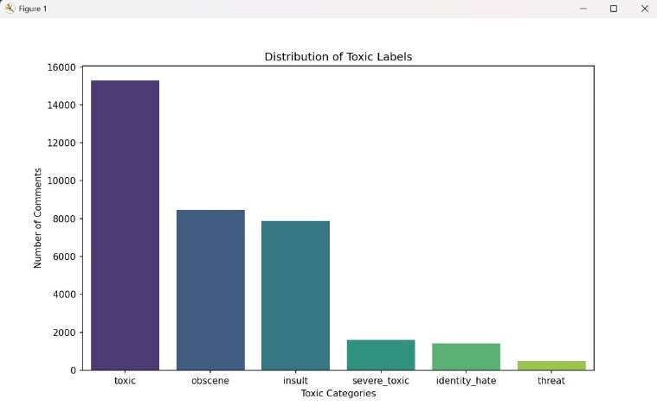
02 – Analysis: EDA
ID​ | Comment​ | Label 1​ | Label 2 ...​
​ | ​ | ​ | ​
Train Shape: (159571,8)
Test Shape: (63978,8)
Baseline Accuracies:
Toxic: 90.42%
Severe toxic: 99.00%
Obscene: 94.71%
Threat: 99.70%
Insult: 95.06%
Identity hate: 99.12%
Low percentage of positive examples
Label distribution of train dataset

Slide 6
02 – Analysis: Accuracy
Little improvement on accuracy if any
Very low percentage of positive examples
6090 toxic positive - 9.52%
211 threat positive - 0.33%
Difficult to train an accurate simple model on limited dataset
Also has strong impacts on precision, recall and F1
Label​ | Accuracy​ | Baseline​
Toxic​ | 92.08%​ | 90.42%​
Severe toxic​ | 99.08%​ | 99.00%​
Obscene​ | 95.55%​ | 94.71%​
Threat​ | 99.67%​ | 99.70%​
Insult​ | 95.24%​ | 95.06%​
Identity hate​ | 98.92%​ | 99.12%​
Analysis

Slide 7
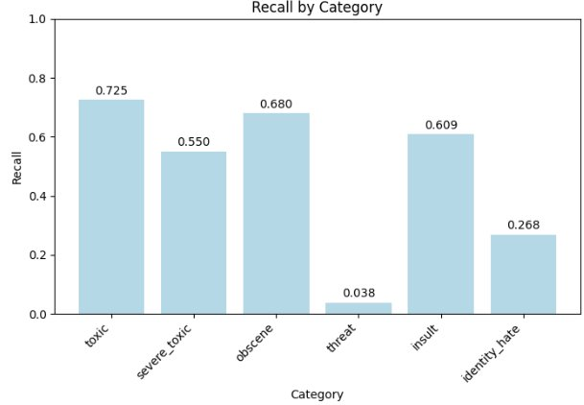
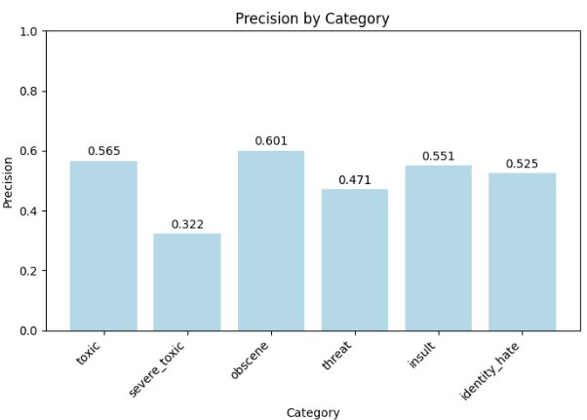
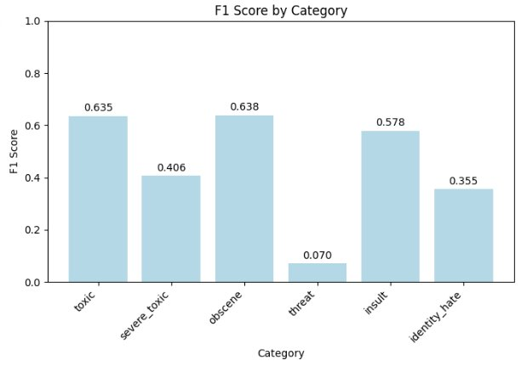
02 – Analysis: Precision,Recall,F1
Low recall - not classifying positives → high false negatives
Toxic comments not being caught
Low precision - high false positives
Innocent comments labeled as toxic
Low F1

Slide 8
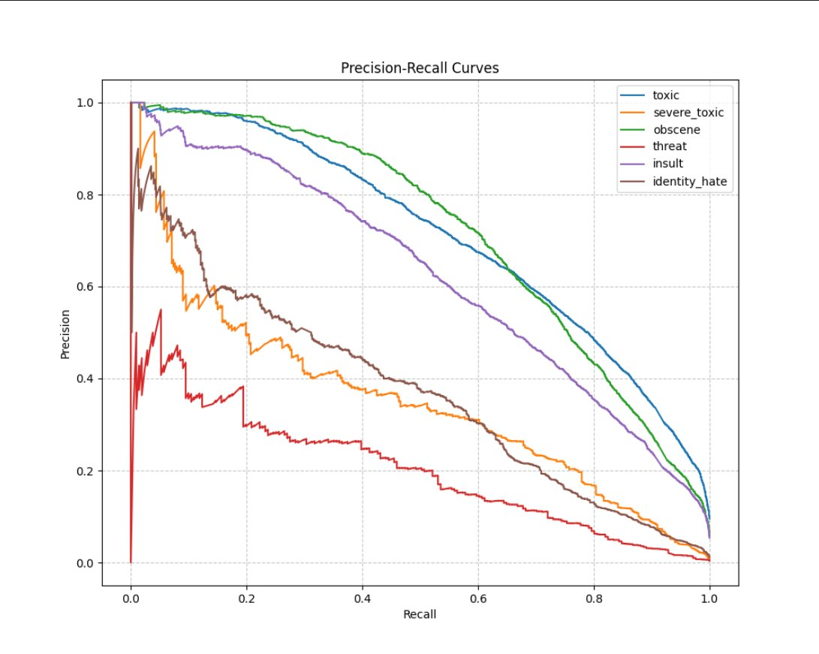
02 –Analysis: Precision recall curve

Slide 9
02 –Analysis
Accuracy improvements marginal (or negative) compared to baseline​
High levels of false positives and false negatives​
Ethical impacts – false or missed reporting
Data missing adequate amounts of certain areas (like threat vs. obscene)
Hard to predict with limited positive data
Would it be better to guess/remove the model?​
Compromise: false positives or false negatives?​
Removing the model will force false negatives​
No reporting vs. Reporting of innocent material​
Challenge for social media platforms​
Making accurate models for changing vocabulary​

Slide 10
Discussion
1. How might your model's false positives (flagging non-toxic comments) affect user experience?​
2. If toxic comments from certain groups are more frequently flagged, what steps could mitigate this bias?​
3. Should platforms prioritize accuracy over inclusivity or vice versa?
Tasked with answering the following prompts
03 – Ethical Discussion

Slide 11
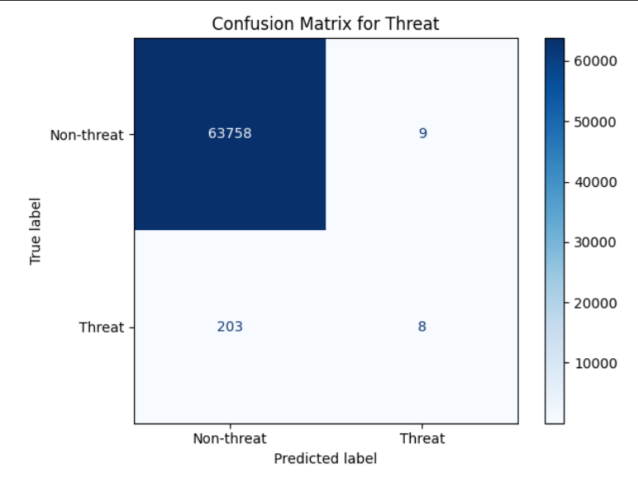
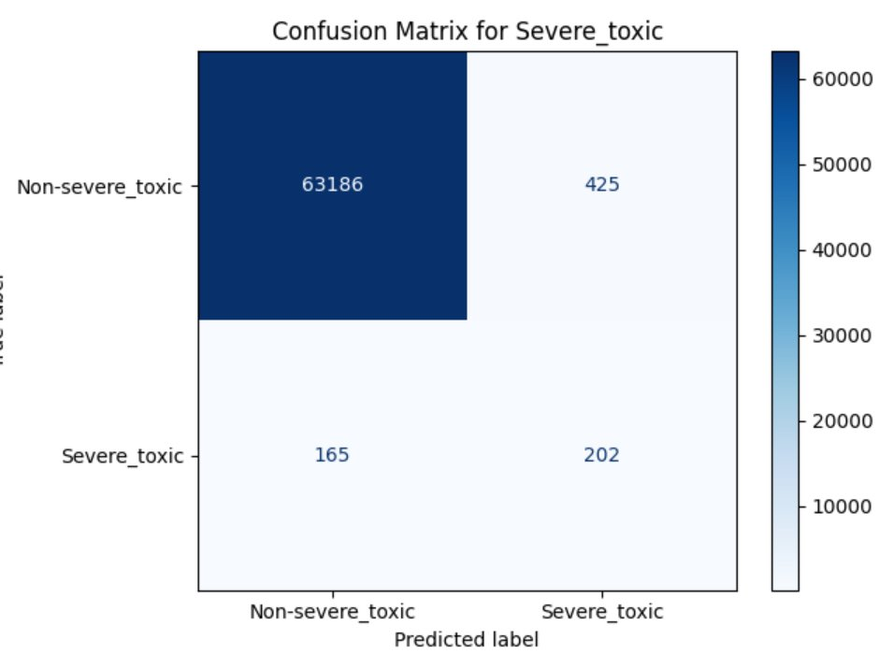
03 – Ethical Discussion
Our model did have some issues with false positives ​
For labels like severe toxic it predicted 627 comments were severely toxic when only 202 actually were​
Can have a large negative impact on user experience​
Frustrates users especially if it happens often enough​
Takes resources away from dealing with false negatives or true positives​
Can leave users feeling confused on what is okay and what is not okay
Discussing our model’s false positives

Slide 12
03 –Ethical Discussion
Fixing bias towards certain
Groups in comment Accuracy vs inclusivity
Classification
Diversifying the dataset to include better group representation (give groups who are flagged more often more positive comments in the set)​
Implement balanced sampling using SMOTE (help to reduce overfitting)​
Try to work with adversarial debiasing ​
Use fairness constraints to more accurately label comments​
Have human checkers at the end of the day to look over the model
Content moderation models should strive for inclusivity over accuracy​
Accuracy is great but if it's accurate for all but one group then that group is going to be marginalized​
If dataset is biased toward one side of a political spectrum then accuracy might cause moderation to heavily target the other side​
Sacrificing some accuracy in the name of better performance across the board is important​
Ideally we want to track both the global and subgroup metrics throughout development
Data analysis facilitates predictive modeling and forecasting

Slide 13
04 – Conclusion
Our model was pretty simple overall
Happy to have seen some decent results with the data we used
We were able to learn a lot about machine learning, internet ethics, and the engineering process
The project demonstrates that the simple TF-IDF + Multinomial Naïve Bayes pipeline can identify some of the toxic content. However, raw accuracy fails to tell the whole picture
Platforms should prioritize inclusivity over accuracy when it comes to text classification
We gained knowledge on ethical implications of censorship on the internet
Knowledge

Slide 14
Thank You
Questions?

